Slide 1
Lightweight RFID Protocol for Medical Privacy Protection in IOT
Kai Fan, Member, IEEE, Wei Jiang, Hui Li, Member, IEEE, and Yintang Yang, Member, IEEE
By:
Osman C. Dsilva
1DS16CS074

Slide 2
Privacy
Privacy is the ability of an individual or group to seclude themselves or information about themselves, and thereby express themselves selectively. When something is private to a person, it usually means that something is inherently special or sensitive to them.
In the case of medical field, important data such as blood type, diagnosis data etc. are vulnerable and have a high risk of being exploited by external agents and hackers.

Slide 3
Authentication
Authentication is the act of proving an assertion, such as the identity of a computer system user. In contrast with identification, the act of indicating a person or thing's identity, authentication is the process of verifying that identity.

Slide 4
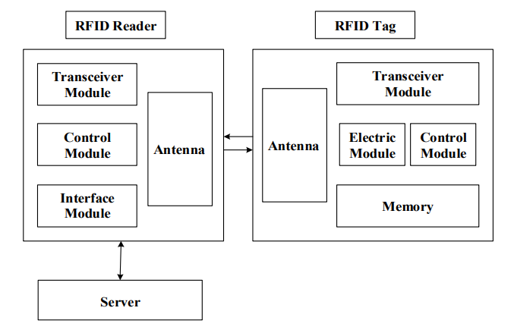
RFID (Radio Frequency Identification)

Slide 5
Working of RFIDs in Medical Field
RFID communication consists of three main components:
RFID Tag
Contain details about the diagnosis, medicinal requirements for the patient, information about last checkups.
RFID Reader
Mobile device capable of reading an RFID tag with 10cm-20cm range.
Reader directs radio frequencies at the tag and the tag gets activated due to this frequency and communicates with the reader.
Server
Back-end database
Used for storage and processing
Authentication

Slide 6
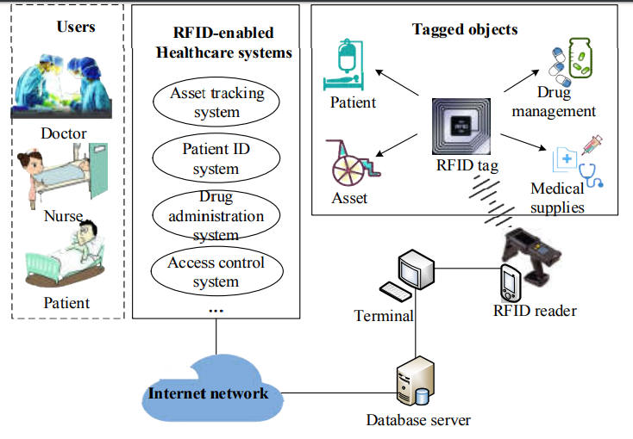
RFID in Medical Field

Slide 7
Security requirements
Anonymity – Keeping the user’s identity a secret
Replay attack resistance – Preventing data transmission repetition
Synchronization – Making sure the tag, reader and the server are in sync
Forward security – Protecting past sessions by protecting the session key
Mutual authentication – Enabling authentication between the tag , reader and server
Non-denial of service. – Prevent DoS attacks

Slide 8
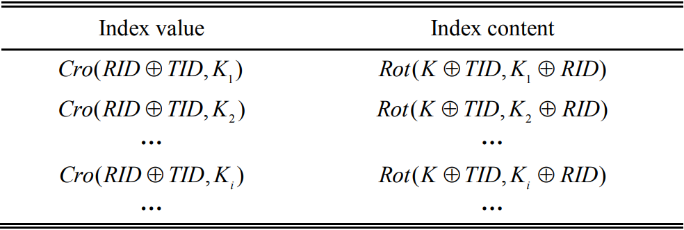
Proposed protocol for authentication
It consists of a IDT (Index Data Table) which consists of index value and index content
It is similar to key-value pairs and these key value pairs are stored in the form of cipher text rather than plain text.

Slide 9
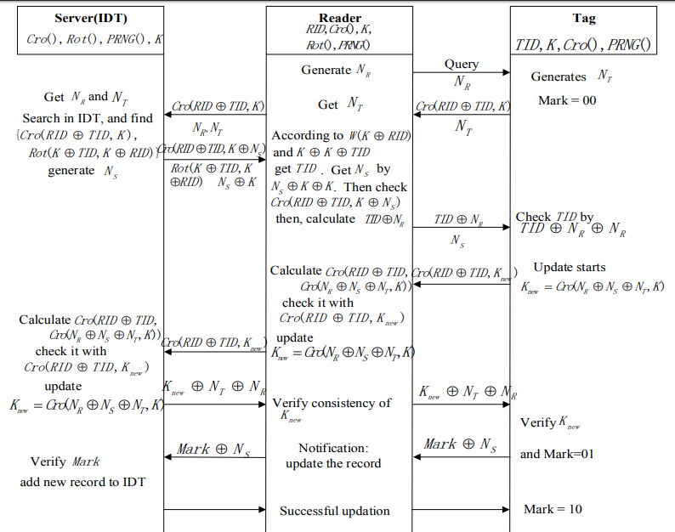
Protocol workflow

Slide 10
Result Analysis
Tag anonymity – The tag ID is transmitted in cipher text format because it is only used for authentication. This ID is stored locally in the tag
Synchronization – The ‘Mark’ flag helps in synchronization by indicating the status of the session
Replay attack resistance - Random numbers are generated for the tag, reader and server for every new session and hence future session cannot be attacked from previous session keys
Forward Secrecy – Attacker cannot get previous session information based on current session due to the generated of fresh random numbers every session
Mutual Authentication – Authentication is obtained between the tag, reader and the server
Anti-DoS attacks – Due to the IDT data storage format key-value pair matching is done and this greatly reduces the chances of the Dos attacks

Slide 11
Computation Cost and Communication Cost
The computation cost is very low because of the XOR, Cro, Rot and hence it is called lightweight.
The bit cross operation used in this protocol is consumes less computational resources in an FPGA system.
The communication costs for the new protocol when compared to other protocols results in the new scheme spending 5 times (which represents the communication times).
In this regard the new protocol is not very efficient in reducing the communication consumption.

Slide 12
Conclusion
The new protocol can resist against the typical attacks.
The authentication of the RFID communication is guaranteed.
This is also verified using BAN logic rules.
It has less computation costs.
It uses index grouping to carry out storage of authenticated data.
Future enhancement can be made to improve the communication cost of the protocol and making it even more efficient.

Slide 13
Thank You

